Slide 1

4th Year Project

Slide 2
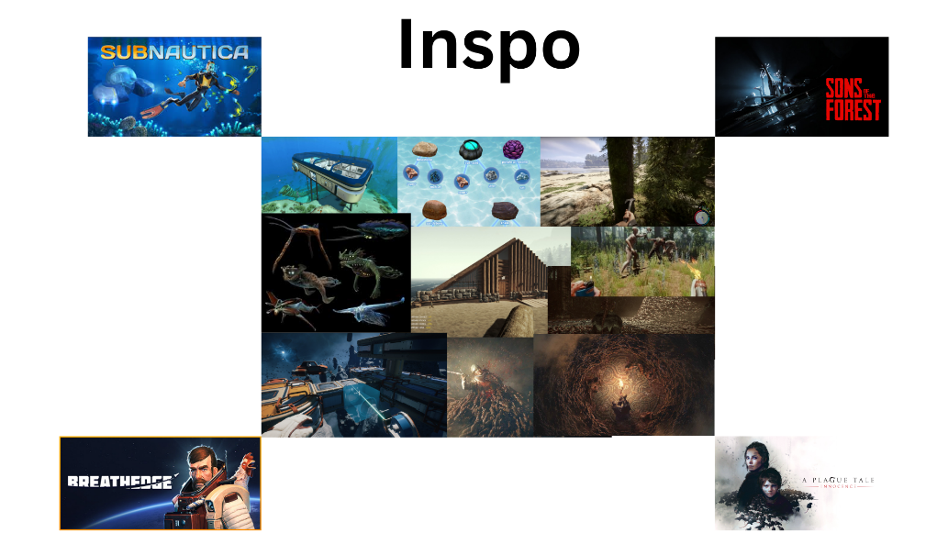

Slide 3
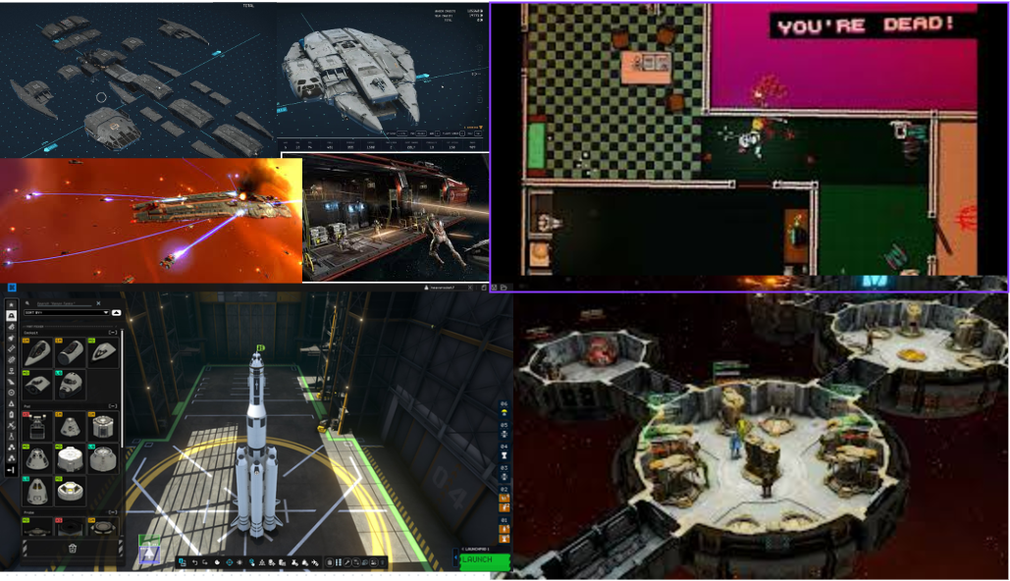

Slide 4
Project interests
Modifiable ships and possibly bases.
Different Parts Effect the flying of the ship ( weight, Acceleration, rotation, origin) and the the different weapons of the ship ( automated cannons, EMP, type of fire rate)
Player be able to create their own ship
Enemies then create their own ships in some slightly random but intelligent way.
Enemies ships also effected by all the parts that get chosen.
Ship destructibility.

Slide 5
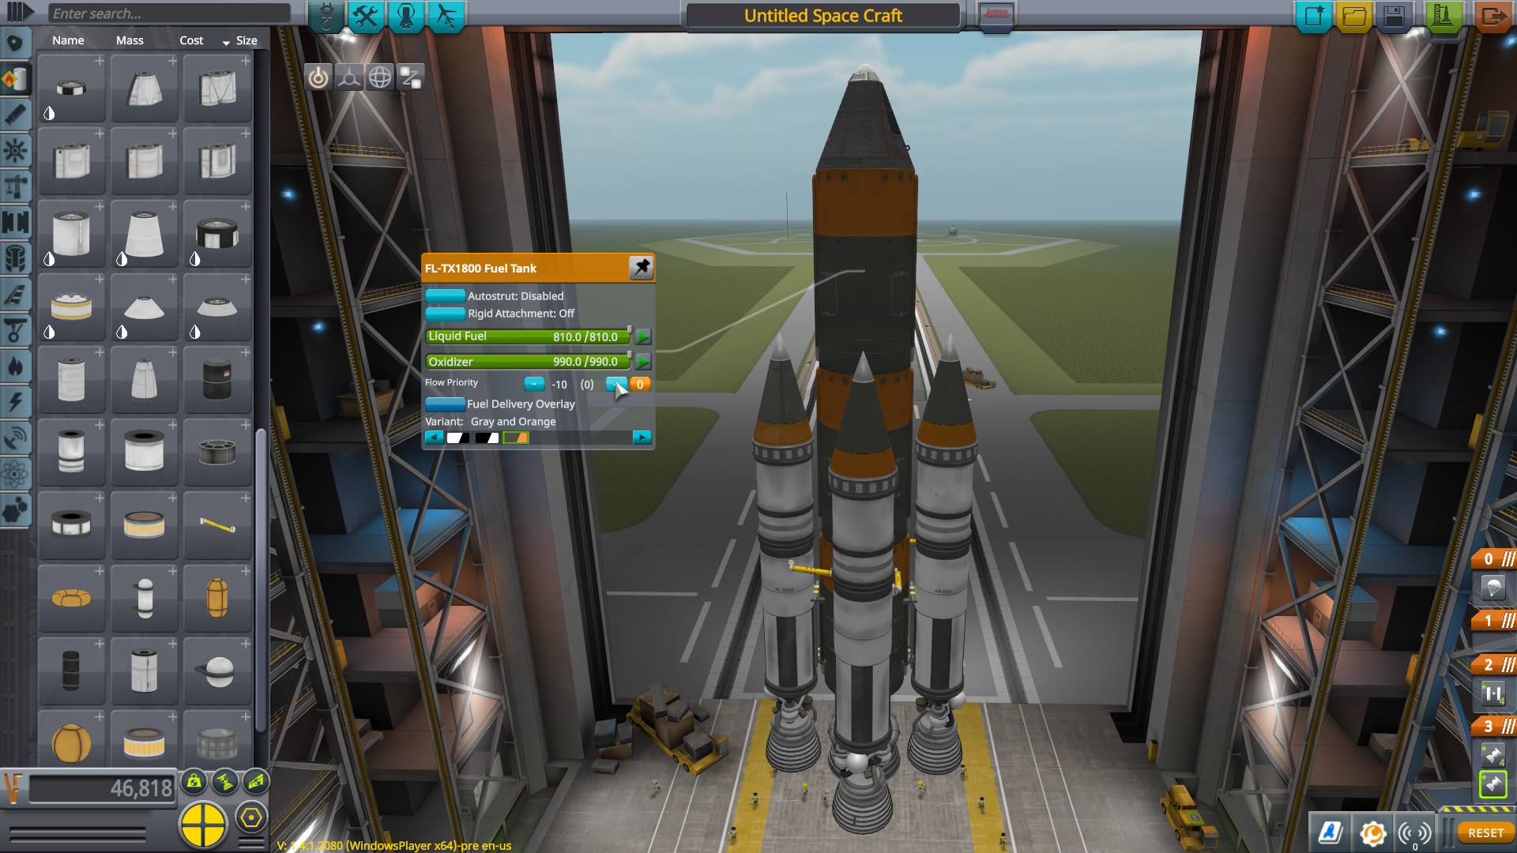
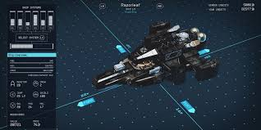
Game Idea
Player can build their own ship in an editor which will tell them part properties.
Not all parts available these will be gained after fight or raiding space stations.

Slide 6
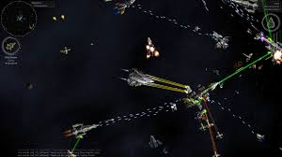
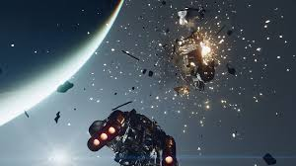
Game Idea
Then will then get in dog fights with enemy who will have been randomly generated.
Destruction will be visualised on ships individual pieces or with particle explosions .

Slide 7
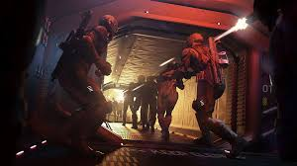
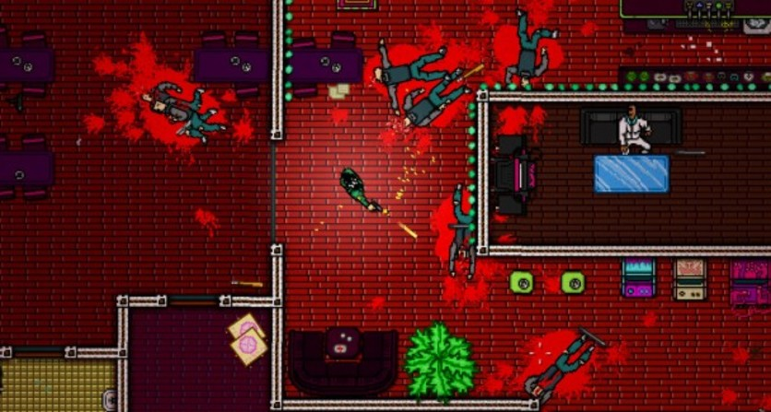
Game Idea
Board ships and space stations to find resources like new ship parts and possibly paint jobs
Where it would turn into a top down shooter like hotline miami

Slide 8
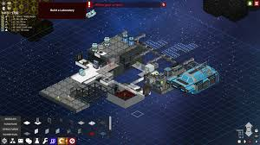
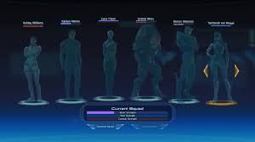
Game Idea Ambition
Possibly even have your own space station where you could have crew recruited from missions
Crew could also act as AI companions when boarding ships or have their own ships during battle

Slide 9
Refer to code to current progress

Slide 10
Editor code

Slide 11
Resource management code

Slide 12
Scene manager code

Slide 13
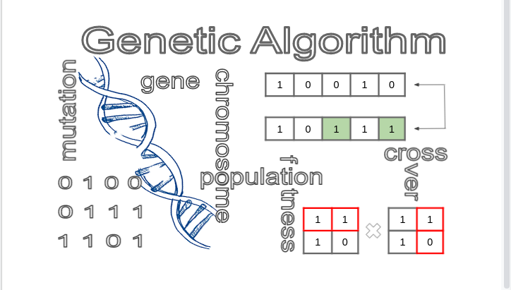
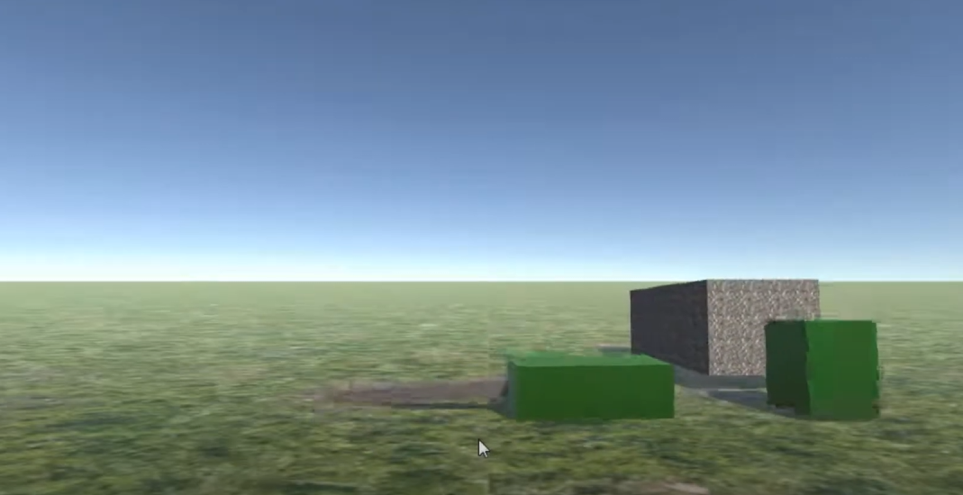
Whats Next?
Ship part effects on flying / fighting
Randomly creating enemy ships
Genetic algorithm for creation of enemy ships?

